Slide 1
Amplicon Sequence Analysis
Lokesh

Slide 2
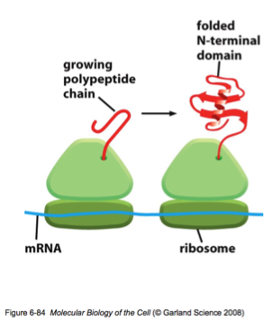
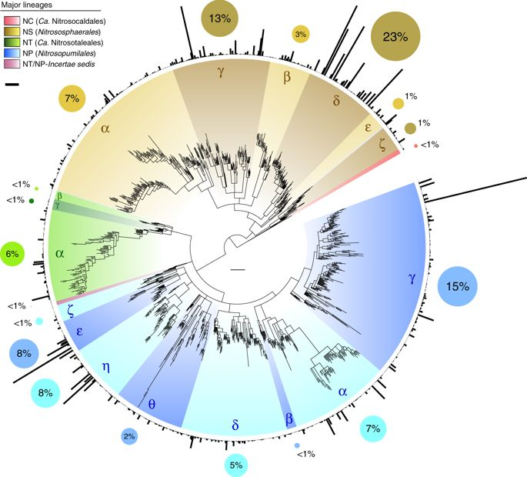
Communities
16S rRNA
AmoA
Why 16S gene?
It’s ubiquitous.
Contains regions that identical across organisms, and regions that are variable across organisms.
AmoA gene
Best marker to understand the diversity and distribution of ammonia oxidising microbes, particularly archaea!
Woese, Microbiol Rev 1987
Alves et al. 2018

Slide 3
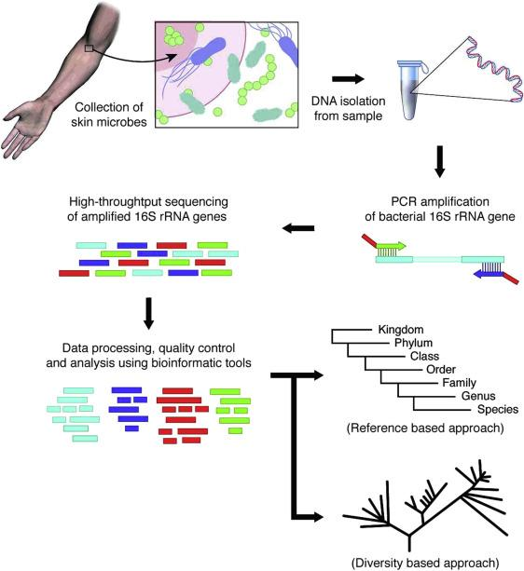
Basics

Slide 4
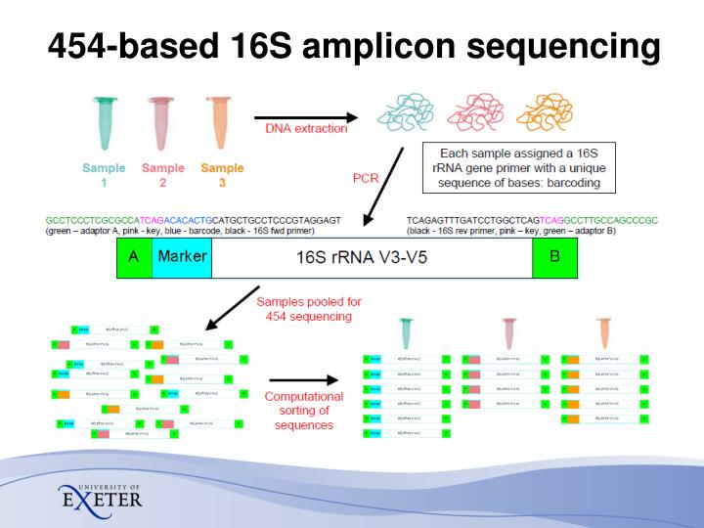
Basics
Slide Credit: Dr. Konrad Paszkiewicz

Slide 5
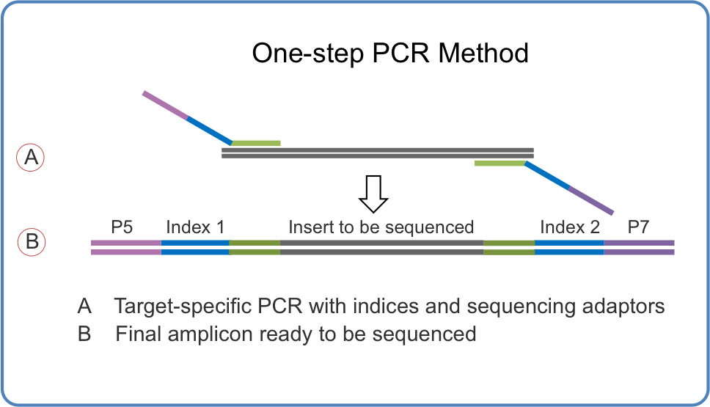
PCR for sequencing
(Ion-Torrent & 454)

Slide 6
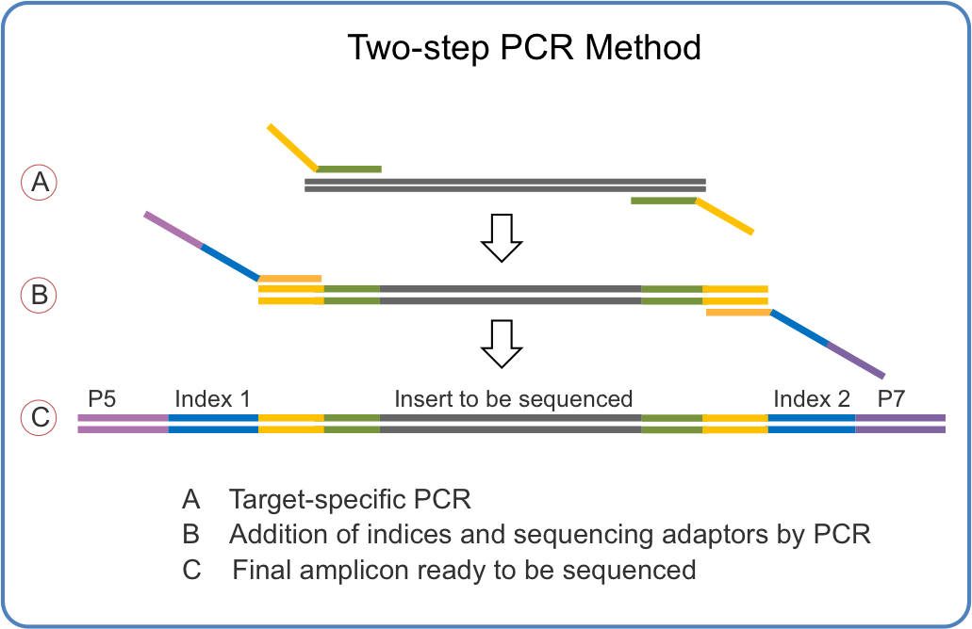
PCR for sequencing
(Illumina MiSeq & HiSeq)

Slide 7
Differences while analysing

Slide 8
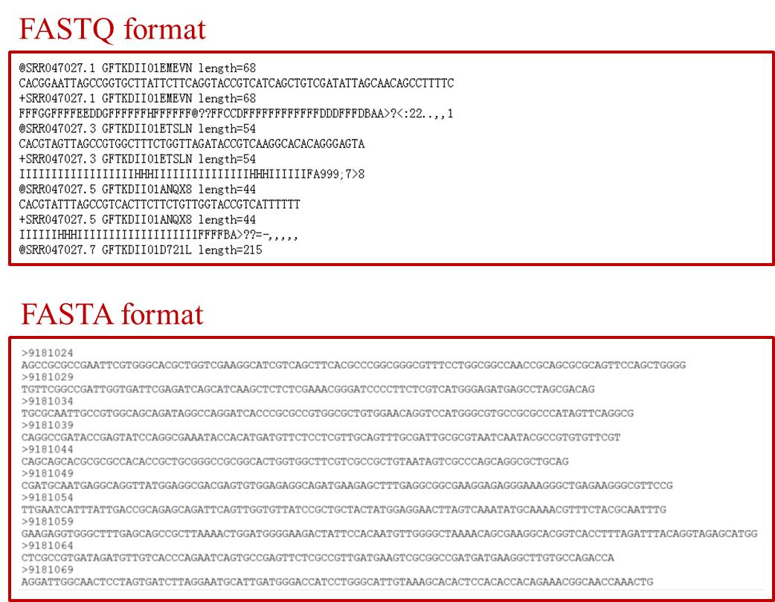
High-Throughput sequencing
Fastq

Slide 9
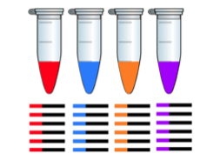
A quick overview
Extract DNA, isolate and amplify the rRNA from all samples using barcoded PCR, and sequence.
Barcoded per-sample rRNA
sample-metadata.tsv
Track per-sample barcodes (e.g., in spreadsheet)
SampleID | BarcodeSequence
4ac2 | AACGCAC
e375 | AAGAGAT
4gd8 | ACAGCAG
9872 | ACAGCTA
Slide Credit: Dr. Daniel McDonald

Slide 10
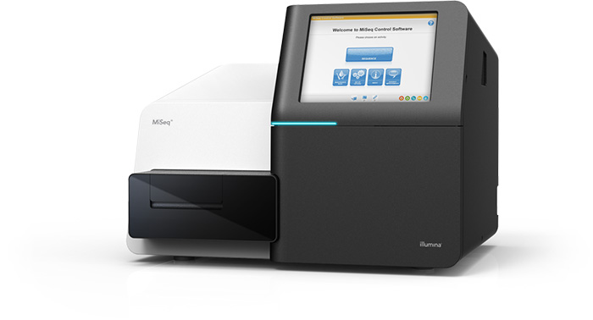
A quick overview
Extract DNA, isolate and amplify the rRNA from all samples using barcoded PCR, and sequence.
Barcoded per-sample rRNA
Pool and sequence samples
sequences.fastq(.gz)
@HWI-6X_9267:1:1:25:1051
GACGAAGGTGACGACCGTTGCTCGGAATCACTGGGCATAAAGCGCGCGTAGGTGGCTTGGTAAGTCCATGGTGAAATCCCTCGGCTCAACCGAGGAACTG
+
abaaaaa`^`a_]^\``\``a`^`]]]^^`a[VXGX``Z_\\\_^\a^SYOZVVSVYGYVDXOZVT\TITBBBBBBBBBBBBBBBBBBBBBBBBBBBBBB
@HWI-6X_9267:1:1:25:267
TACGTATGGGGCAAGCGTTATCCGGAATTATTGGGCGTAAAGAGTGCGTAGGTGGTGGCTTAAGCGCAGGGTTTAAGGCAATGGCTTAACTATTGTTCTC
+
aa^^[__^^^_^_^[^^[^^____ZZ[^^[^]ZUZ]]WUZXYU[Q[X]UVXVN[XUWWURZUYY]XXRZRNVTRTNTWUUU^VJVOMIHQU\URRN[BBB
@HWI-6X_9267:1:1:25:609
TACGTAGGGGGCAAGCGTTATCCGGATTTACTGGGTGTAAAGGGAGCGTAGACGGATGGACAAGTCTGATGTGAAAGGCTGGGGCTCAACCCCGGGACGG
+
aaab`aaa`aaaaaaaaaaaaaaaa^aaaaaaaaYQ^`_^]a_]\a`a]``]Z_[][I^^aZZ^WW^_^`ZZ_T]XY^^\^ZX\ZJS[W[V^\HOVYTET
@HWI-6X_9267:1:1:25:519
GACGGAGGATGCAAGTGTTATCCGGAATCACTGGGCGTAAAGCGTCTGTAGGTGGTTTACTAAGTCAACTGTTAAATCTTGAGGCTCAACCTCGAAATCG
+
abaaaaaa`aaaaaa\aaaaaaa```aa_aaaa^Z__[ZY^aa`U[`^[]]YZ]WY]]_Z_XX\\[]]]^`[\XTVX]`T_VZ[]ZXVXYFX_VYJWWZL
@HWI-6X_9267:1:1:25:1109
TACGGAGGGTGCGAGCGTTAATCGGAATTACTGGGCGTAAAGCGTACGTAGGCGGTTAGGTAAGTCAGATGTGAAAGCCCCGGGCTCCACCTGGGAATGG
+
aaaba^`a^N_`\_``a_a]Zaa^^\Z`[M]a`[VYa^_X^_Z]NZ\`]TY\]_^RVH_PHOWZM[PTRPTRYUBBBBBBBBBBBBBBBBBBBBBBBBBB
barcodes.fastq(.gz)
@HWI-6X_9267:1:1:25:1051
AACGCAC
+
bbbbbbb
@HWI-6X_9267:1:1:25:267
AAGAGAT
+
bbbbbbb
@HWI-6X_9267:1:1:25:609
AACGCAC
+
bbbbbbb
@HWI-6X_9267:1:1:25:519
ACAGCAG
+
bbbbbbb
@HWI-6X_9267:1:1:25:1109
ACAGCTA
+
bbbbbbb
@HWI-6X_9267:1:1:25:434
ACACGAG
+
bbbbbbb
@HWI-6X_9267:1:1:25:597
ACAGCTA
+
bbbbbbb
sample-metadata.tsv
Track per-sample barcodes (e.g., in spreadsheet)
SampleID | BarcodeSequence
4ac2 | AACGCAC
e375 | AAGAGAT
4gd8 | ACAGCAG
9872 | ACAGCTA
Slide Credit: Dr. Daniel McDonald

Slide 11
Demultiplexed sequence data
Multiplexed sequence data
4ac2.fastq(.gz)
sample-metadata.tsv
@HWI-6X_9267:1:1:25:1051
GACGAAGGTGACGACCGTTGCTCGGAATCACTGGGCATAAAGCGCGCGTAGGTGGCTTGGTAAGTCCATGGTGAAATCCCTCGGCTCAACCGAGGAACTG
+
abaaaaa`^`a_]^\``\``a`^`]]]^^`a[VXGX``Z_\\\_^\a^SYOZVVSVYGYVDXOZVT\TITBBBBBBBBBBBBBBBBBBBBBBBBBBBBBB
@HWI-6X_9267:1:1:25:609
TACGTAGGGGGCAAGCGTTATCCGGATTTACTGGGTGTAAAGGGAGCGTAGACGGATGGACAAGTCTGATGTGAAAGGCTGGGGCTCAACCCCGGGACGG
+
aaab`aaa`aaaaaaaaaaaaaaaa^aaaaaaaaYQ^`_^]a_]\a`a]``]Z_[][I^^aZZ^WW^_^`ZZ_T]XY^^\^ZX\ZJS[W[V^\HOVYTET
e375.fastq(.gz)
SampleID | BarcodeSequence
4ac2 | AACGCAC
e375 | AAGAGAT
4gd8 | ACAGCAG
9872 | ACAGCTA
@HWI-6X_9267:1:1:25:267
TACGTATGGGGCAAGCGTTATCCGGAATTATTGGGCGTAAAGAGTGCGTAGGTGGTGGCTTAAGCGCAGGGTTTAAGGCAATGGCTTAACTATTGTTCTC
+
aa^^[__^^^_^_^[^^[^^____ZZ[^^[^]ZUZ]]WUZXYU[Q[X]UVXVN[XUWWURZUYY]XXRZRNVTRTNTWUUU^VJVOMIHQU\URRN[BBB
4gd8.fastq(.gz)
@HWI-6X_9267:1:1:25:519
GACGGAGGATGCAAGTGTTATCCGGAATCACTGGGCGTAAAGCGTCTGTAGGTGGTTTACTAAGTCAACTGTTAAATCTTGAGGCTCAACCTCGAAATCG
+
abaaaaaa`aaaaaa\aaaaaaa```aa_aaaa^Z__[ZY^aa`U[`^[]]YZ]WY]]_Z_XX\\[]]]^`[\XTVX]`T_VZ[]ZXVXYFX_VYJWWZL
9872.fastq(.gz)
@HWI-6X_9267:1:1:25:1109
TACGGAGGGTGCGAGCGTTAATCGGAATTACTGGGCGTAAAGCGTACGTAGGCGGTTAGGTAAGTCAGATGTGAAAGCCCCGGGCTCCACCTGGGAATGG
+
aaaba^`a^N_`\_``a_a]Zaa^^\Z`[M]a`[VYa^_X^_Z]NZ\`]TY\]_^RVH_PHOWZM[PTRPTRYUBBBBBBBBBBBBBBBBBBBBBBBBBB
or
sequences.fastq(.gz)
@HWI-6X_9267:1:1:25:1051
GACGAAGGTGACGACCGTTGCTCGGAATCACTGGGCATAAAGCGCGCGTAGGTGGCTTGGTAAGTCCATGGTGAAATCCCTCGGCTCAACCGAGGAACTG
+
abaaaaa`^`a_]^\``\``a`^`]]]^^`a[VXGX``Z_\\\_^\a^SYOZVVSVYGYVDXOZVT\TITBBBBBBBBBBBBBBBBBBBBBBBBBBBBBB
@HWI-6X_9267:1:1:25:267
TACGTATGGGGCAAGCGTTATCCGGAATTATTGGGCGTAAAGAGTGCGTAGGTGGTGGCTTAAGCGCAGGGTTTAAGGCAATGGCTTAACTATTGTTCTC
+
aa^^[__^^^_^_^[^^[^^____ZZ[^^[^]ZUZ]]WUZXYU[Q[X]UVXVN[XUWWURZUYY]XXRZRNVTRTNTWUUU^VJVOMIHQU\URRN[BBB
@HWI-6X_9267:1:1:25:609
TACGTAGGGGGCAAGCGTTATCCGGATTTACTGGGTGTAAAGGGAGCGTAGACGGATGGACAAGTCTGATGTGAAAGGCTGGGGCTCAACCCCGGGACGG
+
aaab`aaa`aaaaaaaaaaaaaaaa^aaaaaaaaYQ^`_^]a_]\a`a]``]Z_[][I^^aZZ^WW^_^`ZZ_T]XY^^\^ZX\ZJS[W[V^\HOVYTET
@HWI-6X_9267:1:1:25:519
GACGGAGGATGCAAGTGTTATCCGGAATCACTGGGCGTAAAGCGTCTGTAGGTGGTTTACTAAGTCAACTGTTAAATCTTGAGGCTCAACCTCGAAATCG
+
abaaaaaa`aaaaaa\aaaaaaa```aa_aaaa^Z__[ZY^aa`U[`^[]]YZ]WY]]_Z_XX\\[]]]^`[\XTVX]`T_VZ[]ZXVXYFX_VYJWWZL
@HWI-6X_9267:1:1:25:1109
TACGGAGGGTGCGAGCGTTAATCGGAATTACTGGGCGTAAAGCGTACGTAGGCGGTTAGGTAAGTCAGATGTGAAAGCCCCGGGCTCCACCTGGGAATGG
+
aaaba^`a^N_`\_``a_a]Zaa^^\Z`[M]a`[VYa^_X^_Z]NZ\`]TY\]_^RVH_PHOWZM[PTRPTRYUBBBBBBBBBBBBBBBBBBBBBBBBBB
barcodes.fastq(.gz)
@HWI-6X_9267:1:1:25:1051
AACGCAC
+
bbbbbbb
@HWI-6X_9267:1:1:25:267
AAGAGAT
+
bbbbbbb
@HWI-6X_9267:1:1:25:609
AACGCAC
+
bbbbbbb
@HWI-6X_9267:1:1:25:519
ACAGCAG
+
bbbbbbb
@HWI-6X_9267:1:1:25:1109
ACAGCTA
+
bbbbbbb
@HWI-6X_9267:1:1:25:434
ACACGAG
+
bbbbbbb
@HWI-6X_9267:1:1:25:597
ACAGCTA
+
bbbbbbb
Slide Credit: Dr. Daniel McDonald

Slide 12
If data is still multiplexed, assign sequence reads to samples (i.e., demultiplex or demux).
barcodes.fastq(.gz)
sequences.fastq(.gz)
@HWI-6X_9267:1:1:25:1051
AACGCAC
+
Bbbbbbb
@HWI-6X_9267:1:1:25:267
AAGAGAT
+
bbbbbbb
@HWI-6X_9267:1:1:25:609
AACGCAC
+
bbbbbbb
@HWI-6X_9267:1:1:25:519
ACAGCAG
+
bbbbbbb
@HWI-6X_9267:1:1:25:1109
ACAGCTA
+
bbbbbbb
@HWI-6X_9267:1:1:25:1051
GACGAAGGTGACGACCGTTGCTCGGAATCACTGGGCATAAAGCGCGCGTAGGTGGCTTGGTAAGTCCATGGTGAAATCCCTCGGCTCAACCGAGGAACTG
+
abaaaaa`^`a_]^\``\``a`^`]]]^^`a[VXGX``Z_\\\_^\a^SYOZVVSVYGYVDXOZVT\TITBBBBBBBBBBBBBBBBBBBBBBBBBBBBBB
@HWI-6X_9267:1:1:25:267
TACGTATGGGGCAAGCGTTATCCGGAATTATTGGGCGTAAAGAGTGCGTAGGTGGTGGCTTAAGCGCAGGGTTTAAGGCAATGGCTTAACTATTGTTCTC
+
aa^^[__^^^_^_^[^^[^^____ZZ[^^[^]ZUZ]]WUZXYU[Q[X]UVXVN[XUWWURZUYY]XXRZRNVTRTNTWUUU^VJVOMIHQU\URRN[BBB
@HWI-6X_9267:1:1:25:609
TACGTAGGGGGCAAGCGTTATCCGGATTTACTGGGTGTAAAGGGAGCGTAGACGGATGGACAAGTCTGATGTGAAAGGCTGGGGCTCAACCCCGGGACGG
+
aaab`aaa`aaaaaaaaaaaaaaaa^aaaaaaaaYQ^`_^]a_]\a`a]``]Z_[][I^^aZZ^WW^_^`ZZ_T]XY^^\^ZX\ZJS[W[V^\HOVYTET
@HWI-6X_9267:1:1:25:519
GACGGAGGATGCAAGTGTTATCCGGAATCACTGGGCGTAAAGCGTCTGTAGGTGGTTTACTAAGTCAACTGTTAAATCTTGAGGCTCAACCTCGAAATCG
+
abaaaaaa`aaaaaa\aaaaaaa```aa_aaaa^Z__[ZY^aa`U[`^[]]YZ]WY]]_Z_XX\\[]]]^`[\XTVX]`T_VZ[]ZXVXYFX_VYJWWZL
@HWI-6X_9267:1:1:25:1109
TACGGAGGGTGCGAGCGTTAATCGGAATTACTGGGCGTAAAGCGTACGTAGGCGGTTAGGTAAGTCAGATGTGAAAGCCCCGGGCTCCACCTGGGAATGG
+
aaaba^`a^N_`\_``a_a]Zaa^^\Z`[M]a`[VYa^_X^_Z]NZ\`]TY\]_^RVH_PHOWZM[PTRPTRYUBBBBBBBBBBBBBBBBBBBBBBBBBB
sample-metadata.tsv
SampleID | BarcodeSequence
4ac2 | AACGCAC
e375 | AAGAGAT
4gd8 | ACAGCAG
9872 | ACAGCTA

Slide 13
Sequence quality control, and optionally grouping sequences by similarity (i.e., OTU picking).
FeatureTable[Frequency]
 | feature1 | feature2 | feature3 | feature4 | feature5
4ac2 | 42 | 0 | 37 | 99 | 1
e375 | 12 | 1 | 22 | 88 | 0
4gd8 | 25 | 3 | 23 | 86 | 0
9872 | 0 | 0 | 87 | 12 | 0
SampleData[SequencesWithQuality]
4ac2.fastq(.gz)
@HWI-6X_9267:1:1:25:1051
GACGAAGGTGACGACCGTTGCTCGGAATCACTGGGCATAAAGCGCGCGTAGGTGGCTTGGTAAGTCCATGGTGAAATCCCTCGGCTCAACCGAGGAACTG
+
abaaaaa`^`a_]^\``\``a`^`]]]^^`a[VXGX``Z_\\\_^\a^SYOZVVSVYGYVDXOZVT\TITBBBBBBBBBBBBBBBBBBBBBBBBBBBBBB
@HWI-6X_9267:1:1:25:609
TACGTAGGGGGCAAGCGTTATCCGGATTTACTGGGTGTAAAGGGAGCGTAGACGGATGGACAAGTCTGATGTGAAAGGCTGGGGCTCAACCCCGGGACGG
+
aaab`aaa`aaaaaaaaaaaaaaaa^aaaaaaaaYQ^`_^]a_]\a`a]``]Z_[][I^^aZZ^WW^_^`ZZ_T]XY^^\^ZX\ZJS[W[V^\HOVYTET
e375.fastq(.gz)
@HWI-6X_9267:1:1:25:267
TACGTATGGGGCAAGCGTTATCCGGAATTATTGGGCGTAAAGAGTGCGTAGGTGGTGGCTTAAGCGCAGGGTTTAAGGCAATGGCTTAACTATTGTTCTC
+
aa^^[__^^^_^_^[^^[^^____ZZ[^^[^]ZUZ]]WUZXYU[Q[X]UVXVN[XUWWURZUYY]XXRZRNVTRTNTWUUU^VJVOMIHQU\URRN[BBB
4gd8.fastq(.gz)
@HWI-6X_9267:1:1:25:519
GACGGAGGATGCAAGTGTTATCCGGAATCACTGGGCGTAAAGCGTCTGTAGGTGGTTTACTAAGTCAACTGTTAAATCTTGAGGCTCAACCTCGAAATCG
+
abaaaaaa`aaaaaa\aaaaaaa```aa_aaaa^Z__[ZY^aa`U[`^[]]YZ]WY]]_Z_XX\\[]]]^`[\XTVX]`T_VZ[]ZXVXYFX_VYJWWZL
9872.fastq(.gz)
@HWI-6X_9267:1:1:25:1109
TACGGAGGGTGCGAGCGTTAATCGGAATTACTGGGCGTAAAGCGTACGTAGGCGGTTAGGTAAGTCAGATGTGAAAGCCCCGGGCTCCACCTGGGAATGG
+
aaaba^`a^N_`\_``a_a]Zaa^^\Z`[M]a`[VYa^_X^_Z]NZ\`]TY\]_^RVH_PHOWZM[PTRPTRYUBBBBBBBBBBBBBBBBBBBBBBBBBB
FeatureData[Sequence]
>feature5
GACGAAGGTGACGACCGTTGCTCGGAATCACTGGGCATAAAGCGCGCGTAGGTGGCTTGGTAAGTCCATGGTGAAATCCCTCGGCTCAACCGAGGAACTG
>feature4
TACGTAGGGGGCAAGCGTTATCCGGATTTACTGGGTGTAAAGGGAGCGTAGACGGATGGACAAGTCTGATGTGAAAGGCTGGGGCTCAACCCCGGGACGG
>feature2
TACGTATGGGGCAAGCGTTATCCGGAATTATTGGGCGTAAAGAGTGCGTAGGTGGTGGCTTAAGCGCAGGGTTTAAGGCAATGGCTTAACTATTGTTCTC
>feature1
GACGGAGGATGCAAGTGTTATCCGGAATCACTGGGCGTAAAGCGTCTGTAGGTGGTTTACTAAGTCAACTGTTAAATCTTGAGGCTCAACCTCGAAATCG
>feature3
TACGGAGGGTGCGAGCGTTAATCGGAATTACTGGGCGTAAAGCGTACGTAGGCGGTTAGGTAAGTCAGATGTGAAAGCCCCGGGCTCCACCTGGGAATGG

Slide 14
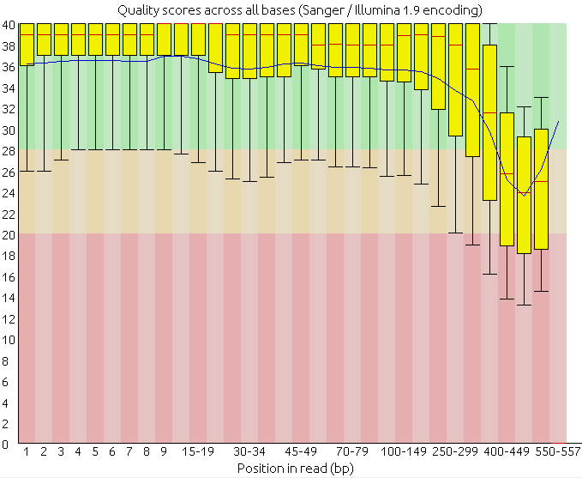
Sequence quality

Slide 15
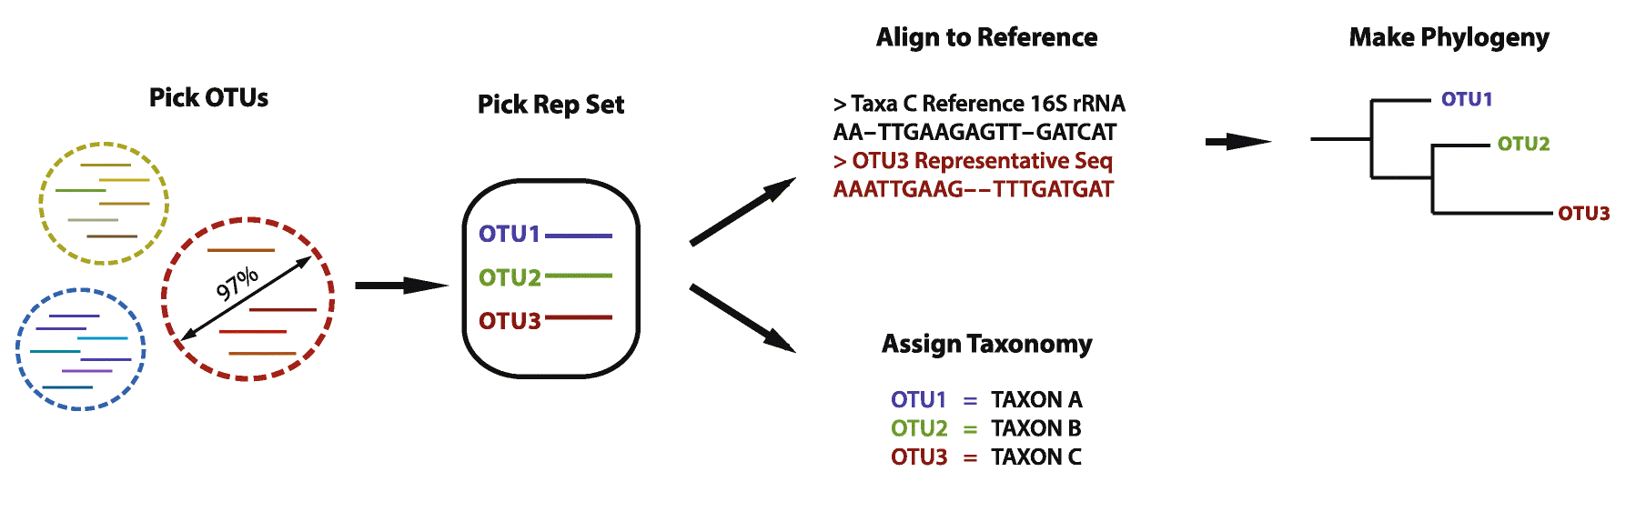
Traditional workflow
After sequence processing for quality, removed primers and chimeras

Slide 16
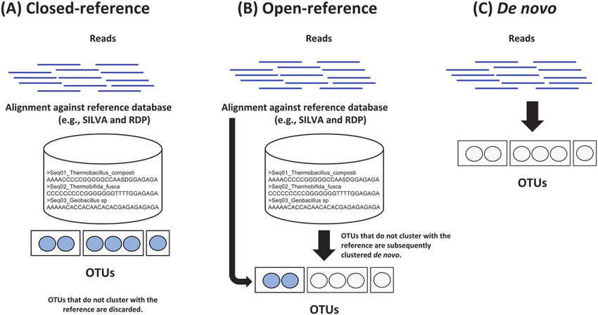
OTU picking

Slide 17
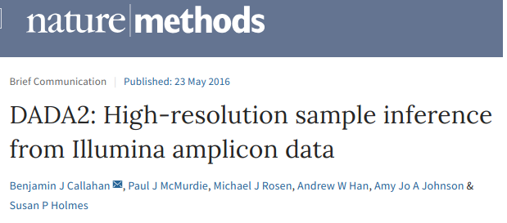

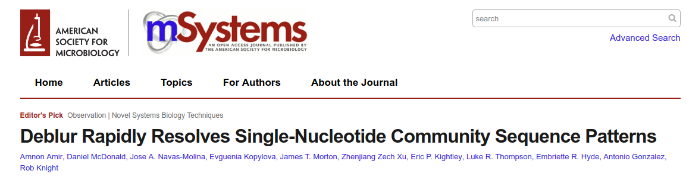
Amplicon sequence variants (ASV)

Slide 18
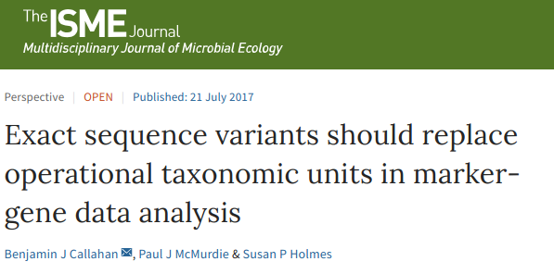
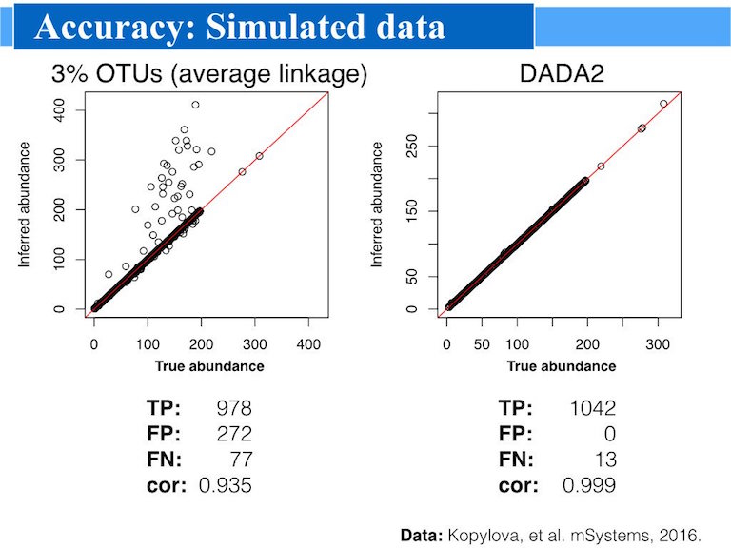
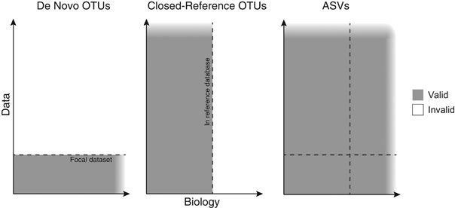
ASV over OTU

Slide 19


Slide 20
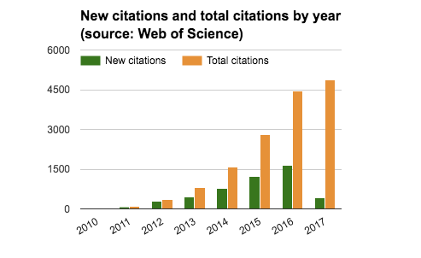
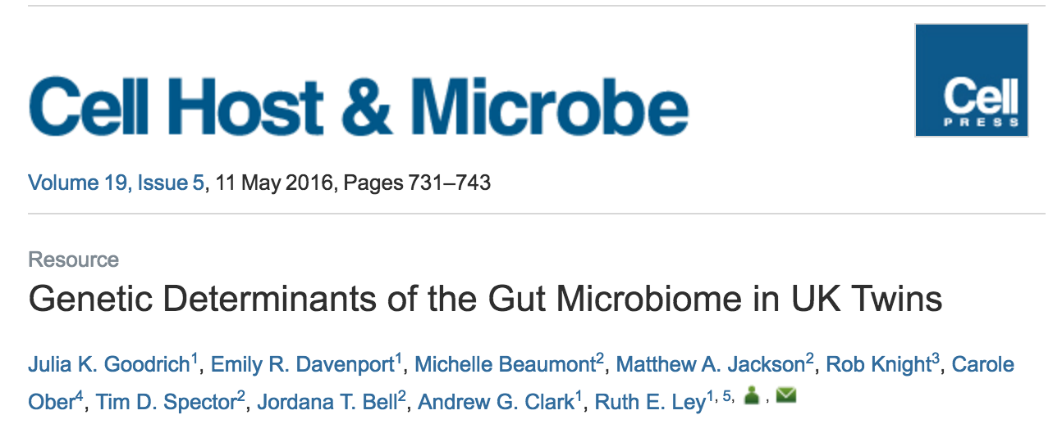
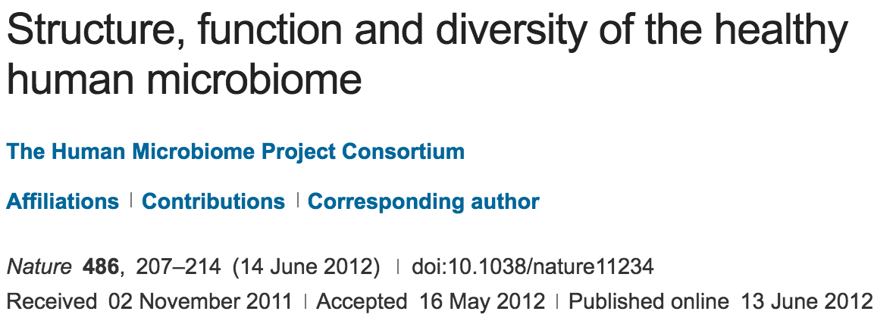
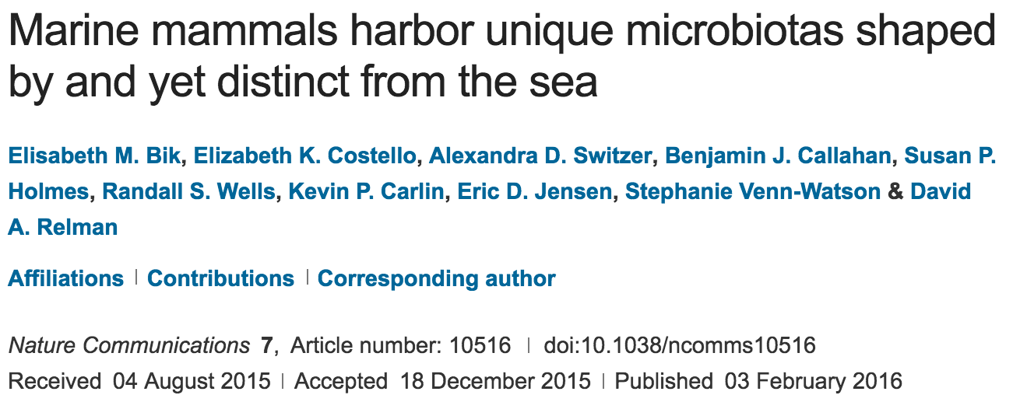
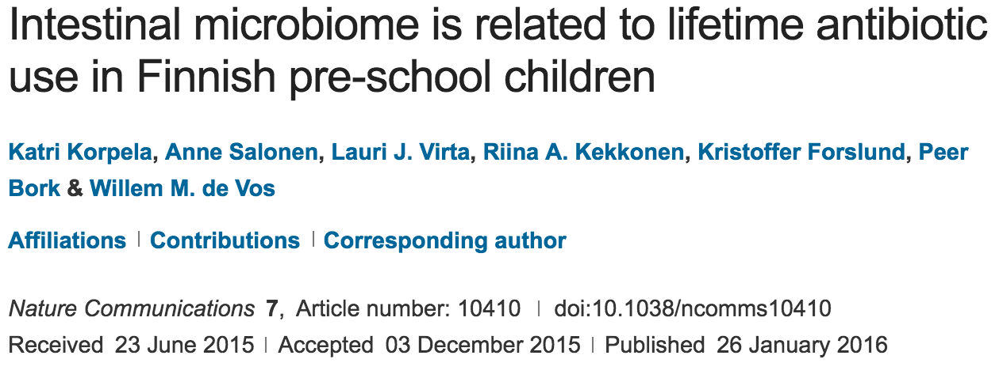

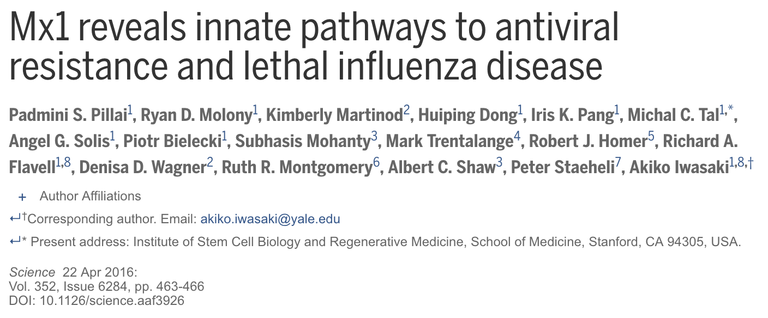
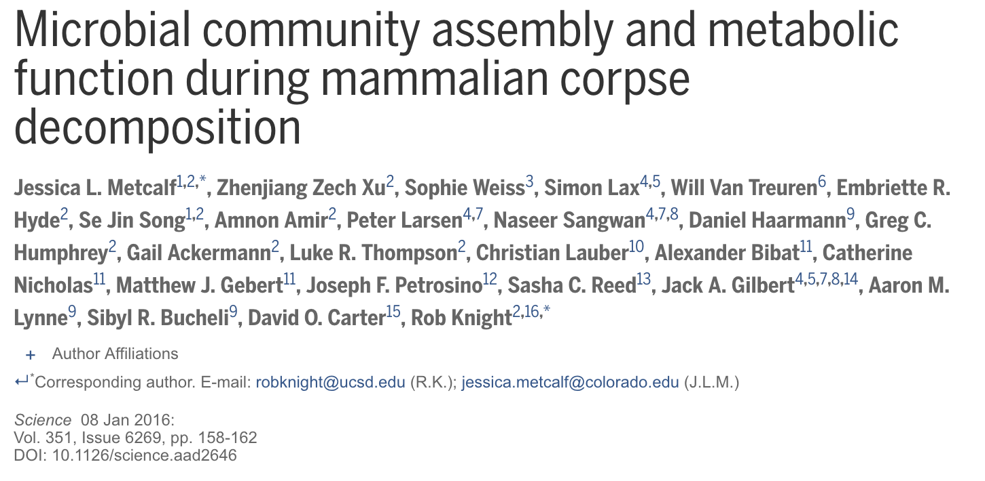
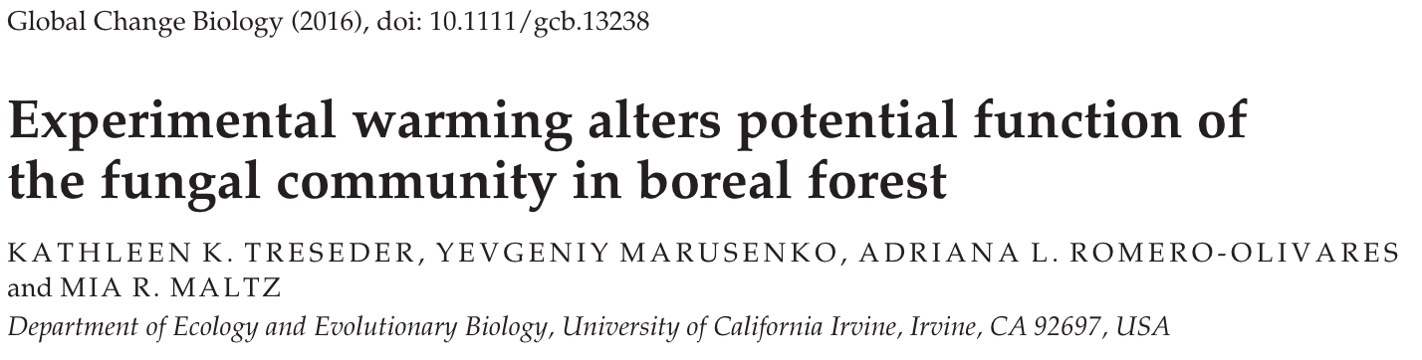
QIIME citations since publication
Google Scholar: ~9550
Web of Science: ~5169

Slide 21
Exploring .qza and .qzv
They are .zip files, just with a different extension.
The data/ directory holds your data, and metadata.yaml tells QIIME 2 what your data is.

Slide 22
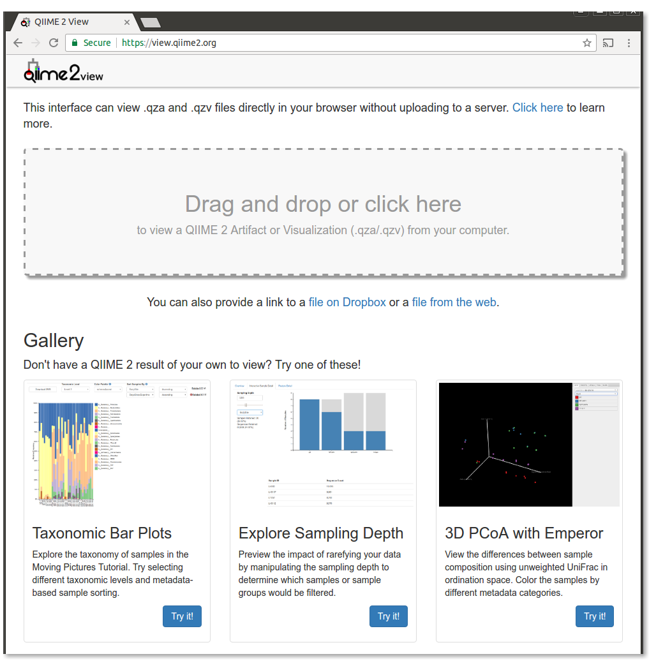
q2view: a read-only web interface for viewing results without having QIIME 2 installed
Reads QIIME 2 outputs (QZAs and QZVs)
Browser-based software (via Service Workers!)
Static site (no application server)
No uploading!
Easily share visualizations with collaborators
https://view.qiime2.org (live demo)

Slide 23
Some Bash course flashback

Slide 24
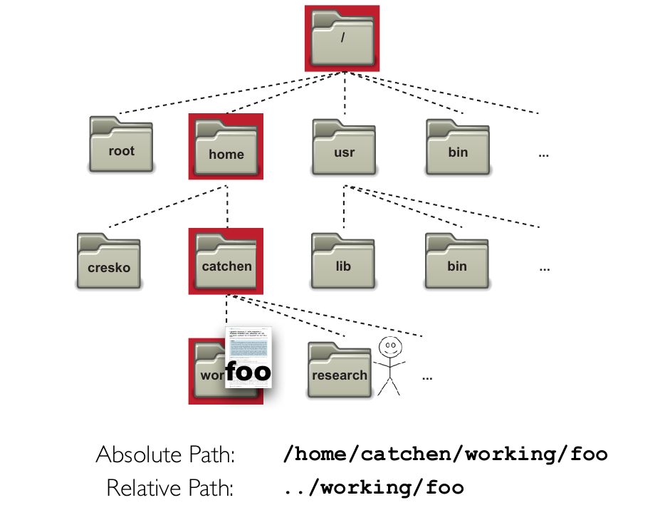

Slide 25
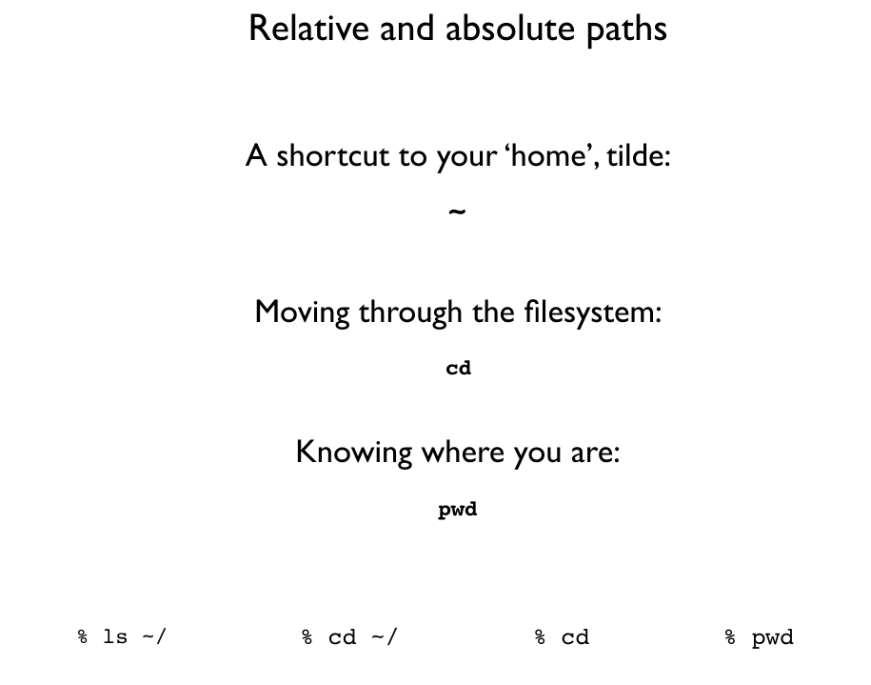

Slide 26
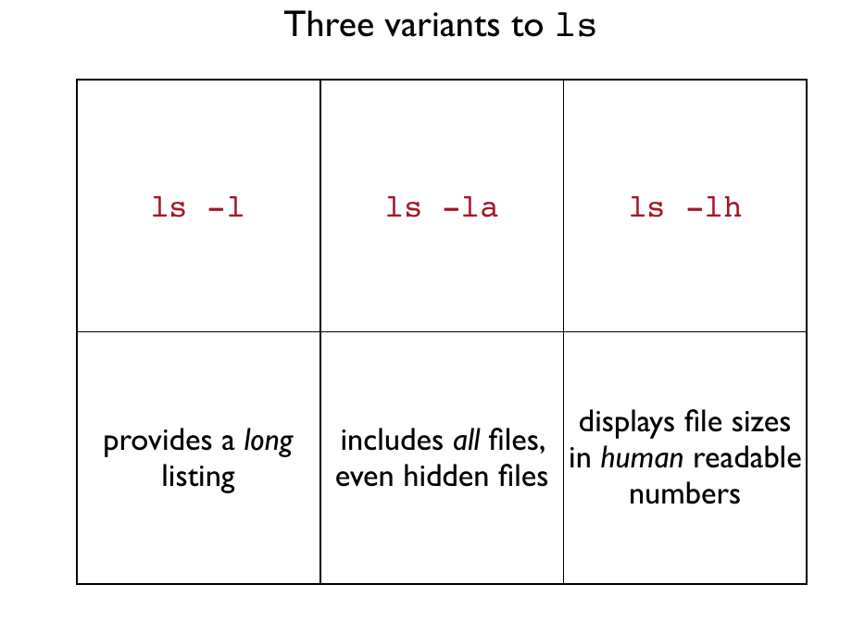

Slide 27
Important notes before
Case-Sensitive
Tab completion (!?)
Single-tab and Double tab
Spaces “ ” mean a lot!
Naming files without spaces!
File extensions
The remove command “rm” is dangerous

Slide 28
Quoting
% echo '$USER'
% $USER
% echo “$USER”
% bagnoud
% echo $USER
% bagnoud
% echo \”
% ”
% echo \>
% >
% echo “>”
% >
% echo ‘>’
% >
% echo >
syntax error

Slide 29
Redirection
% echo hello > test.txt # Write to file
% echo “hello” >> test.txt # Append to file
% cat test.txt # Print to screen

Slide 30
Summary1
man manual for bash commands
ls list directory content
ls -l list directory content with more detail
cd DIRNAME change the directory to DIRNAME
mkdir DIRNAME make subdirectory DIRNAME

Slide 31
Four ways to view a text file
less | head | tail | cat
view a text file one screen full at a time | view top 10 lines of a file | view last 10 lines of a file | spit the whole file at once
space-bar: scroll q: quit | -n <number> controls the number of lines | -n <number> controls the number of lines

Slide 32
Summary2
cat printing input to output
COMMAND > FILENAME put the output of the COMMAND into a file named FILENAME
cp FILENAME1 FILENAME2 makes a copy of FILENAME1 called FILENAME2
mv FILENAME1 FILENAME2 renames FILENAME1 to FILENAME2
mv FILENAME1 PATH/FILENAME2 moves the file FILENAME1 to the specified PATH and names it to FILENAME2
rm FILENAME removes FILENAME
rmdir DIRNAME remove subdirectory DIRNAME
find PATH -name PATTERN search, starting from PATH for a file that has a name that matches PATTERN.

Slide 33

https://github.com/lokeshbio/Amplicon_course

Slide 35
Some additional slides

Slide 36

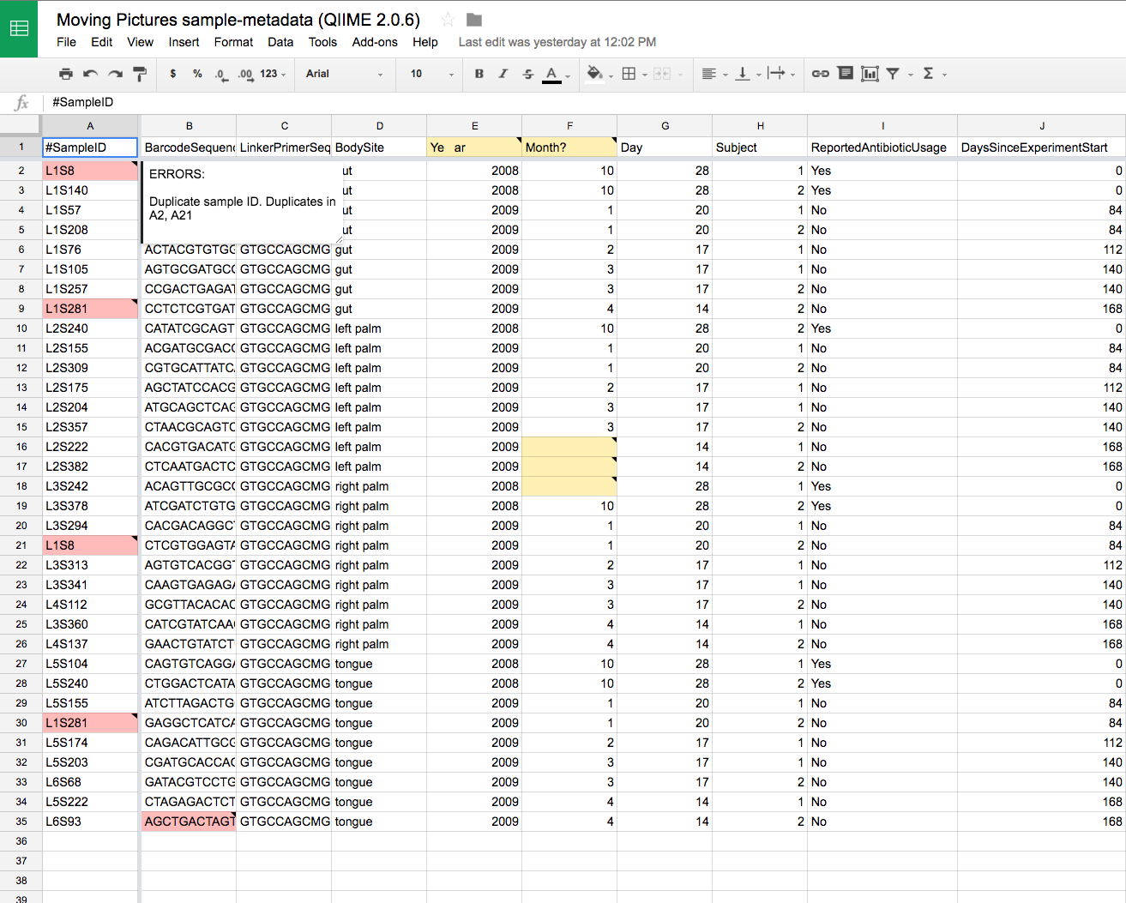
Sample metadata: formatting
Keemei: cloud-based validation of tabular bioinformatics file formats in Google Sheets.
Rideout JR, Chase JH, Bolyen E, Ackermann G, González A, Knight R, Caporaso JG.
GigaScience. 2016;5:27.
http://keemei.qiime.org

Slide 37
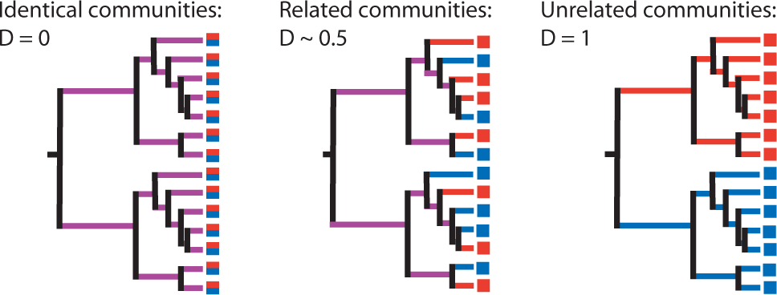
UniFrac: Exploiting Evolution to
Compare Communities
Lozupone and Knight, Appl Environ Microbiol 2005

Slide 38
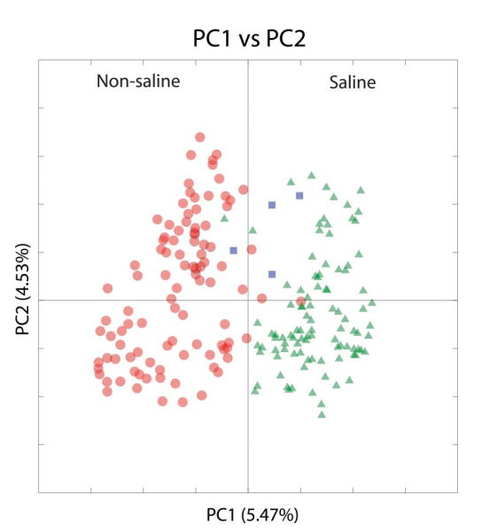
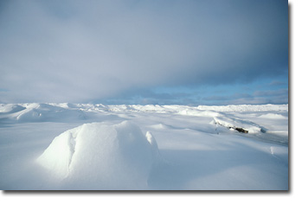
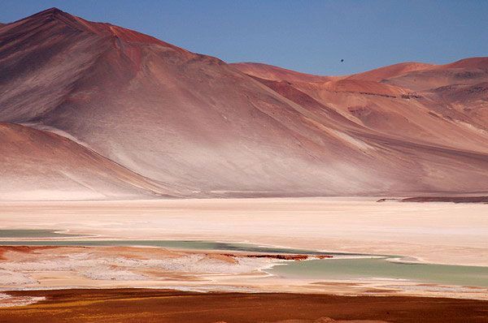
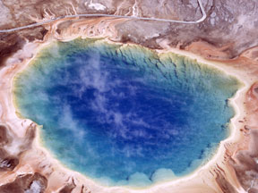
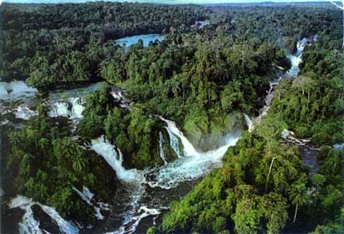
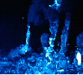
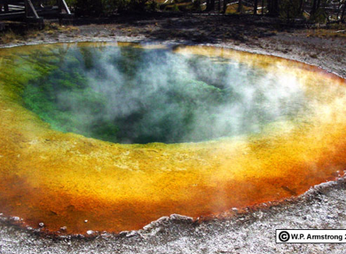
A microbe dominated world
Lozupone and Knight PNAS. 2007 Jul 3;104(27):11436-40
Notes:
Go anywhere in the environment and you can find microbial life
drivers of the global ecosystem
Estimated at 10^30 cells (whitman)

